Slide 1
QIIME 2 Tutorial
Benjamin Brobbey, Vishnu Sekar, Harrison Muller

Slide 2
Assignment
Run the “Moving Pictures” QIIME 2 Tutorial
Explain how to use QIIME 2 commands
Compare Diversity and Comparative Analyses

Slide 3
What is QIIME 2?
“QIIME 2 is a powerful, extensible, and decentralized microbiome analysis package with a focus on data analysis transparency”
Raw DNA Sequence → Figures and Stats
Amplicon Sequencing
Features
Data Provenance Tracking
Semantic Type System
Plugin System for Extended Functionality
Multiple User Interfaces
Notes:
QIIME 2 is a versatile microbiome analysis platform designed for processing raw DNA sequences and produces informative visuals and statistics. It specializes in amplicon sequencing data, and has features like data provenance tracking to ensure analysis transparency. It also employs a semantic type system to organize data effectively and a plugin system for extending functionality. With support for multiple user interfaces, it caters to a diverse user base, making microbiome analysis accessible and efficient.

Slide 4
Important QIIME 2 Concepts
QIIME 2 Artifacts
Output data known as artifacts
Data & Metadata
.qza
Visualizations
Output files like artifacts
Tables, Graphs, Etc.
.qzv
view.qiime2.org
Semantics
Automatically detects proper files to use
Plugins
Analysis performed via plugins
Demux, Diversity, Etc.
Notes:
In QIIME 2, key concepts shape the microbiome analysis workflow. Its Artifacts represent output data, such as DNA sequences and statistical results, saved in a standardized ".qza" format for consistency. Data & Metadata provide context to the analyses, while visual aids are effective in communication through ".qzv" files. QIIME 2 automatically detects proper files, and streamlines the analysis with Semantics. As mentioned earlier, plugins increase its flexibility, facilitating a diverse analyses like Demux and Diversity. This framework offers a comprehensive and transparent approach to microbiome analysis.

Slide 5
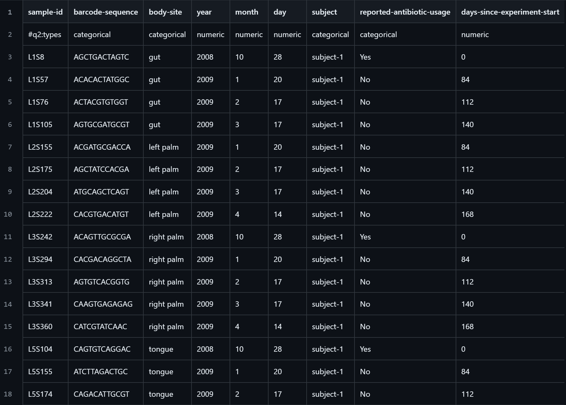
Data
Sample-metadata.tsv
Microbiome sample from two individuals from four body site at five time points
EMP-single-end-sequences
Sequenced on an Illumina HiSeq using the Earth Microbiome Project hypervariable region 4 (V4) 16S rRNA sequencing protocol
Barcode.fasta.gz & sequences.fasta.gz
Notes:
What are we doing in this tutorial
Performing a microbiome analysis on 2 people from 4 body sites and 5 times.
One person took antibiotics
Sample-metadata => Includes info on the subjects, barcode, dates => reference
EMP-single-end
Sequenced using EMP 16S rRNA protocol
Includes barcodes and sequences files in fasta format

Slide 6
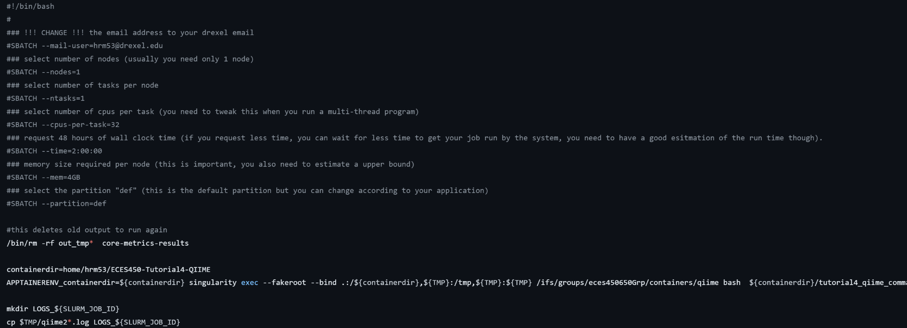
Picotte Containers & Submitter.sh
To run QIIME2 on Picotte, we must run it using a container
Submitter.sh
Connects us to the singular container for QIIME in /eces450650/containers
Includes logs for error checking
Tutorial4_qiime_commands.sh
List of commands to analyze the data
Notes:
We ran our code in picotte
Submitted a job that calls the tutorial file and runs it on the class singular view
Using Apptainer here as it is recommended by the system
See tutorial githubs for more info

Slide 7
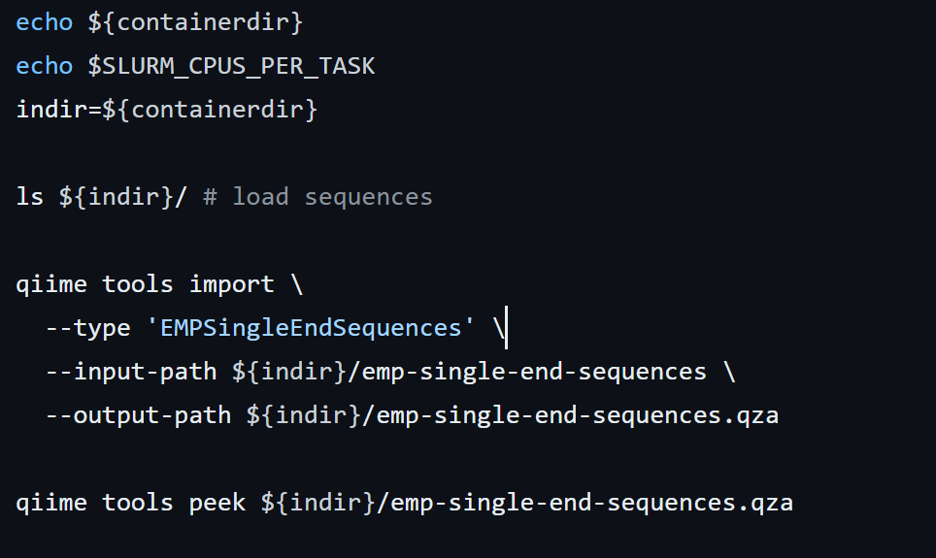
Importing the Data
First step is to download the data
Many options: Manual, wget, etc.
Used curl command
Importing
Need to import our sequence data to an artifact
Check if import was successful
UUID, Type, Format
Notes:
The initial step in this process involves downloading the necessary data, and there’s multiple options for this purpose, such as manually downloading it or using tools like (wget) for automated retrieval from a specified URL. wget is as an efficient tool, as it can automatically access the necessary link and pull the required data. Once you get the data, the next step would be to import it into a structured artifact, so further analysis can occur. During the importation process, it is necessary to verify the success of the import, which can be often assessed through parameters such as UUID (Universally Unique Identifier), type, and format. This ensures a unique identification for the artifact, and understanding its type and format provides important context for the next analytical steps. This process of downloading, importing, and verifying lays the foundation for downstream analyses, allowing researchers to work with the sequence data in a well-organized and accessible format.

Slide 8
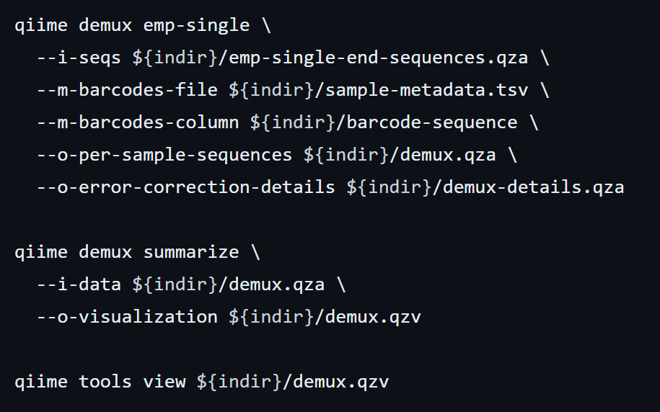
Demultiplexing
QIIME2 artifacts are multiplexed
Sequences not yet assigned to samples
Demultiplexing
Need to know what barcode sequence matches each sample
Information in sample metadata
Results stores in demux.qza
View the visualization using tools
Notes:
Demultiplexing is a big step in the analysis of sequencing data, particularly in high-throughput sequencing projects where multiple samples are pooled together and sequenced simultaneously. In this process, raw sequencing reads that contain unique barcode sequences are separated or "demultiplexed" based on these barcodes, assigning each read to its respective sample. This is essential for accurately associating genetic information with specific samples, allowing downstream analyses to be performed on individual datasets rather than pooled data.
In the context of QIIME2 artifacts, demultiplexing is a critical operation. QIIME2 artifacts are often multiplexed, meaning that sequences from different samples are combined into a single dataset. The sequences within these artifacts are not initially assigned to specific samples, and demultiplexing becomes necessary. This involves determining which barcode sequence corresponds to each sample, and this information is typically extracted from the sample metadata. The demultiplexing process is implemented using tools like emp-single for Earth MicroBiome Project protocol single-end reads. The results of demultiplexing are stored in a QIIME2 artifact file with the extension ".qza," named demux.qza. Subsequently, researchers can visualize and explore the demultiplexed data using various tools provided by QIIME2. This ensures that downstream analyses are conducted on accurately assigned samples, contributing to the reliability of the entire microbiome analysis workflow.

Slide 9
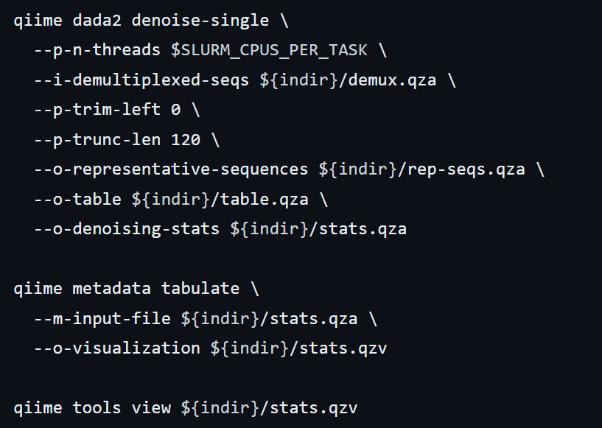
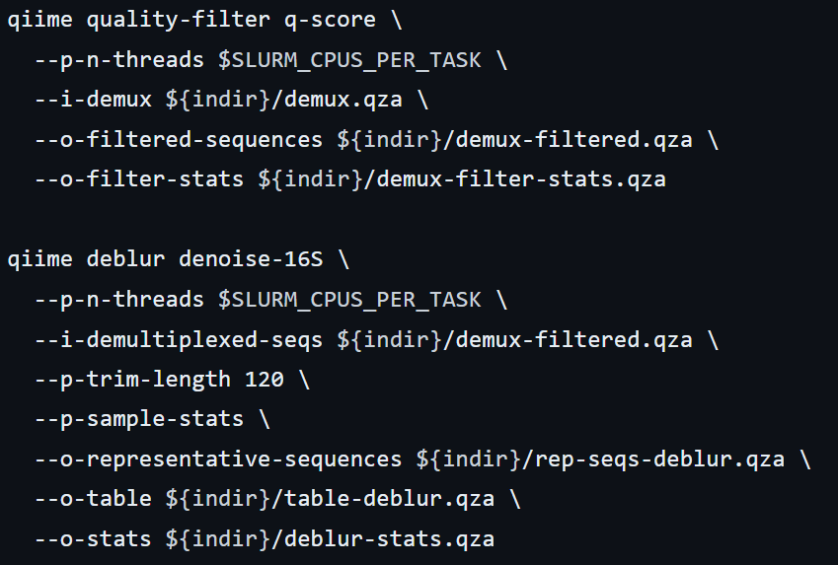
Sequence Quality Control
Multiple Methods
DADA2
Pipeline for detecting Illumina amplicon sequence data
Filters phiX reads and chimeric sequences
Uses two parameters
–p-trim-left m
–p-trunc-len n
Deblur
Uses sequence error profiles to match erroneous sequence reads with their biological sequence
Applied in two steps
Quality filtering process
Deblur workflow (denoise-16s)
–p-trim-length n
Notes:
These steps are interchangeable, so you can use whichever of these you prefer. The result of both of these methods will be a FeatureTable[Frequency] QIIME 2 artifact, which contains counts (frequencies) of each unique sequence in each sample in the dataset, and a FeatureData[Sequence] QIIME 2 artifact, which maps feature identifiers in the FeatureTable to the sequences they represent.
This allows the user to remove low quality regions of the sequences. To determine what values to pass for these two parameters, you should review the Interactive Quality Plot tab in the demux.qzv file that was generated by qiime demux summarize above.
This method requires one parameter that is used in quality filtering, --p-trim-length n which truncates the sequences at position n. In general, the Deblur developers recommend setting this value to a length where the median quality score begins to drop too low.
On these data, the quality plots (prior to quality filtering) suggest a reasonable choice is in the 115 to 130 sequence position range. This is a subjective assessment. One situation where you might deviate from that recommendation is when performing a meta-analysis across multiple sequencing runs.

Slide 10
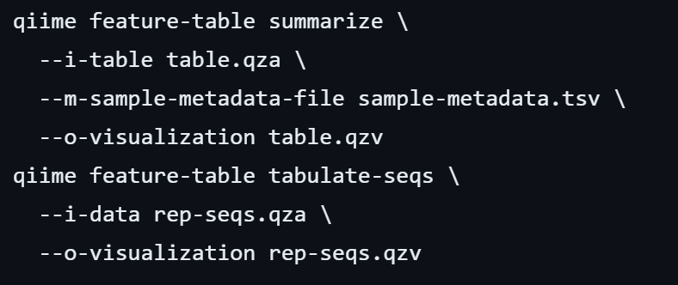
FeatureTables and FeatureData Summaries
Let's explore the data!
Feature-table summarize
Provides information on how many sequences are associated with each sample
Feature-table tabulate seqs
Provides mapping of feature IDs to sequences
Provide links to BLAST each sequence against NCBI database
Notes:
In microbiome analysis, feature tables are vital matrices summarizing the abundance of microbial features across samples. The command feature-table summarize in QIIME2 provides an overview of sequence counts per sample, aiding in assessing sequencing depth and feature distribution. Further exploration with feature-table tabulate seqs maps feature IDs to their sequences, enabling a link to BLAST for taxonomic identification against the NCBI database. This iterative approach allows researchers to delve into the intricacies of microbiome data, ensuring a comprehensive understanding of microbial composition and facilitating meaningful insights in microbiome studies.

Slide 11
Phylogenetic Diversity Analysis
What is It
Biology method that assesses evolutionary relationship
Constructing phylogenetic tree(genetic data based)
Considers presence of species and evolutionary connection
What does it include
Data Collection
Phylogenetic Tree Construction
Diversity Metrics
Analysis of Results
Notes:
Phylogenetic diversity analysis is a method in biology that assesses the evolutionary relationships among species in a community. It involves constructing a phylogenetic tree based on genetic data to understand the evolutionary history of organisms. The process includes collecting data, constructing the phylogenetic tree, calculating diversity metrics, and analyzing the results to understand biodiversity patterns and evolutionary histories.

Slide 12
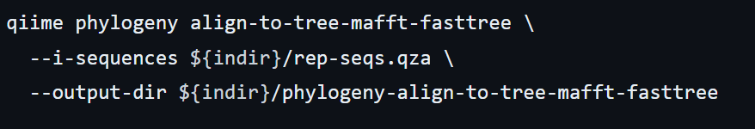
Phylogenetic Diversity Analyses
Support for several methods
Faith’s Phylogenetic Diversity
Weighted & Unweighted Unifrac
Align-to-tree-mafft-fasttree Pipeline
Multiple sequence alignment
Masks variable results
Applies Fasstree
Midpoint rooting
Notes:
In addition to counts of features per sample (i.e., the data in the FeatureTable[Frequency] QIIME 2 artifact), these metrics require a rooted phylogenetic tree relating the features to one another. This information will be stored in a Phylogeny[Rooted] QIIME 2 artifact.
First, the pipeline uses the mafft program to perform a multiple sequence alignment of the sequences in our FeatureData[Sequence] to create a FeatureData[AlignedSequence] QIIME 2 artifact.
Next, the pipeline masks (or filters) the alignment to remove positions that are highly variable. These positions are generally considered to add noise to a resulting phylogenetic tree. Following that, the pipeline applies FastTree to generate a phylogenetic tree from the masked alignment. The FastTree program creates an unrooted tree, so in the final step in this section midpoint rooting is applied to place the root of the tree at the midpoint of the longest tip-to-tip distance in the unrooted tree.

Slide 13
Alpha & Beta Diversity Analysis
Alpha Diversity
Diversity of specific habitat or community
Richness and Evenness
Shannon Index, Simpson’s Index, Faith’s Phylogenetic Diversity, etc.
Beta Diversity
Quantifies the variation in species composition between different habitats or ecosystems
Jaccard Index, Bray-Curtis, etc.
Notes:
Alpha diversity refers to the diversity within a specific habitat or community, encompassing measures of both richness(which is the number of different species), and evenness(how evenly distributed those species are). Common metrics used to quantify alpha diversity include the Shannon Index, Simpson’s Index, and Faith’s Phylogenetic Diversity, among others.
Beta diversity, on the other hand, quantifies the variation in species composition between different habitats or ecosystems. It provides insight into how similar or dissimilar the species composition is among different location. Common metrics for beta diversity include the Jaccard Index and Bray-Curtis dissimilarity, among others.

Slide 14
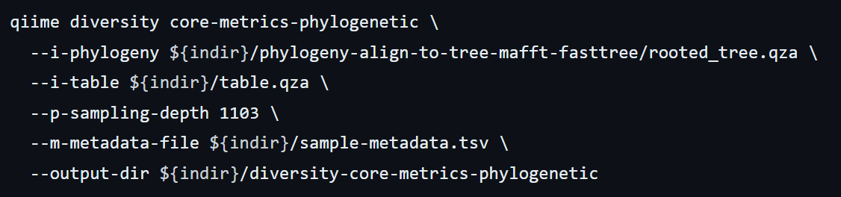
Alpha & Beta Diversity Analysis
Core-Metrics-Phylogenetic
Runs Alpha and Beta Tests
Generates PCoA plots using Emperor
Alpha
Shannon’s Diversity
Faith’s Phylogenetic Diversity
Etc.
Beta
Jaccard Distance
Bray-Curtis
Unifrac
Notes:
apply the core-metrics-phylogenetic method, which rarefies a FeatureTable[Frequency] to a user-specified depth, computes several alpha and beta diversity metrics, and generates principal coordinates analysis (PCoA) plots using Emperor for each of the beta diversity metrics.
An important parameter that needs to be provided to this script is --p-sampling-depth, which is the even sampling (i.e. rarefaction) depth. Because most diversity metrics are sensitive to different sampling depths across different samples, this script will randomly subsample the counts from each sample to the value provided for this parameter.
Here we set the --p-sampling-depth parameter to 1103. This value was chosen based on the number of sequences in the L3S313 sample because it’s close to the number of sequences in the next few samples that have higher sequence counts, and because it is considerably higher (relatively) than the number of sequences in the samples that have fewer sequences.

Slide 15
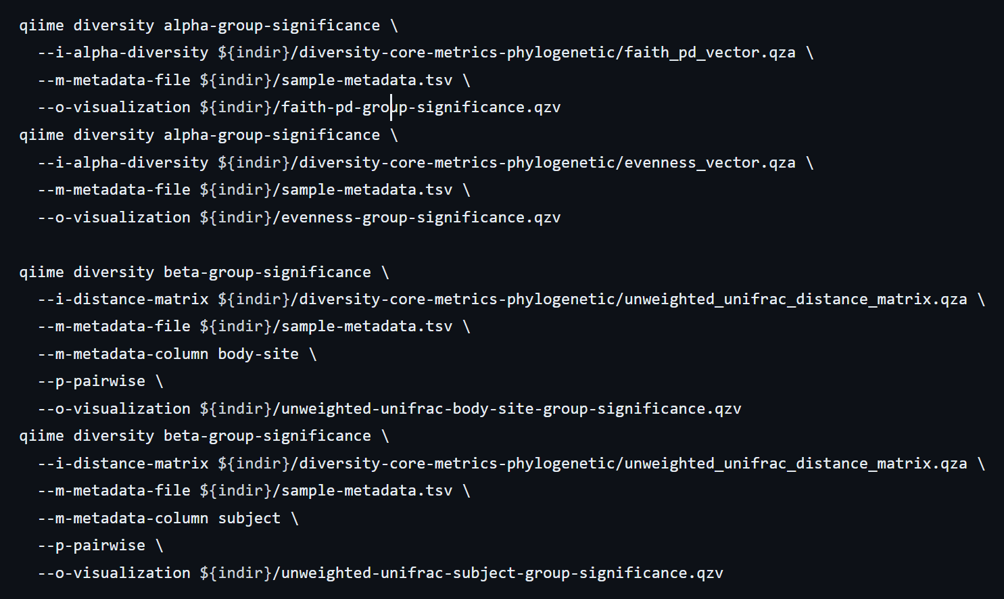
Alpha & Beta Diversity Summaries
Analyze microbial composition of the samples
Test for associations between metadata and alpha diversity
Analyze metadata using PERMANOVA
Test similarities between distances
Notes:
We’ll first test for associations between categorical metadata columns and alpha diversity data. We’ll do that here for the Faith Phylogenetic Diversity (a measure of community richness) and evenness metrics.
In this data set, no continuous sample metadata columns (e.g., days-since-experiment-start) are correlated with alpha diversity, so we won’t test for those associations here. If you’re interested in performing those tests (for this data set, or for others), you can use the qiime diversity alpha-correlation command.
f you call this command with the --p-pairwise parameter, as we’ll do here, it will also perform pairwise tests that will allow you to determine which specific pairs of groups (e.g., tongue and gut) differ from one another, if any.
Here we’ll apply this to our unweighted UniFrac distances, using two sample metadata columns, as follows.
Finally, ordination is a popular approach for exploring microbial community composition in the context of sample metadata. We can use the Emperor tool to explore principal coordinates (PCoA) plots in the context of sample metadata.

Slide 16
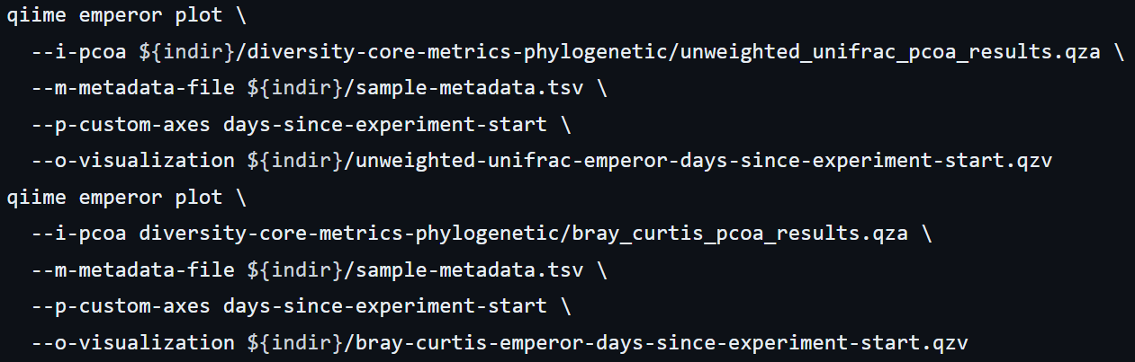
Emperor
Performs ordination to generate PCoA plots
QIIME 2 View
Notes:
Finally, ordination is a popular approach for exploring microbial community composition in the context of sample metadata. We can use the Emperor tool to explore principal coordinates (PCoA) plots in the context of sample metadata.
We will generate Emperor plots for unweighted UniFrac and Bray-Curtis so that the resulting plot will contain axes for principal coordinate 1, principal coordinate 2, and days since the experiment start. We will use that last axis to explore how these samples changed over time.

Slide 17
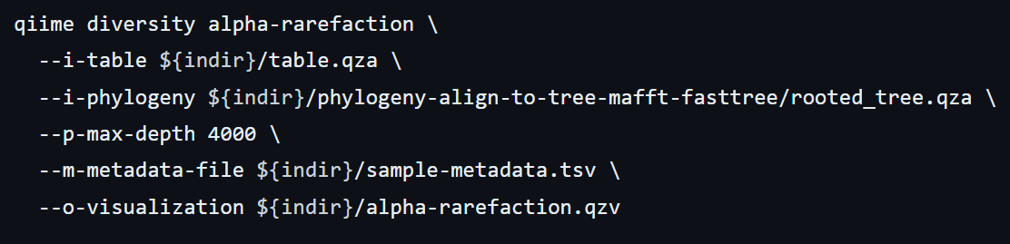
Alpha Rarefaction Plotting
Alpha diversity as a func of sampling depth
Diversity metrics computed for all samples
Diversity values plotted for each sample
Notes:
This visualizer computes one or more alpha diversity metrics at multiple sampling depths, in steps between 1 (optionally controlled with --p-min-depth) and the value provided as --p-max-depth. At each sampling depth step, 10 rarefied tables will be generated, and the diversity metrics will be computed for all samples in the tables. The number of iterations (rarefied tables computed at each sampling depth) can be controlled with --p-iterations. Average diversity values will be plotted for each sample at each even sampling depth, and samples can be grouped based on metadata in the resulting visualization if sample metadata is provided with the --m-metadata-file parameter.

Slide 18
Taxonomic Analysis
Process for categorizing organisms present in the sample
Comparing sequences to reference databases to identify taxonomic affiliation
Studies traits(genetic, behavioral, ecological) and group into hierarchical categories
Analysis of OTU’s (Operational Taxonomic Units) from databases
Greengenes(DNA)
Silva(RNA)
Etc.
Notes:
It categorizes organisms based on their shared characteristics and evolutionary relationships.
The importance of analyzing OTU’s is to characterize and quantify the diversity of microbial communities present in environmental samples, such as soil, water, or the human gut.
GreenGenes and Silva are just two of the reference databases used which helps with the analysis, and there are many others as well.

Slide 19
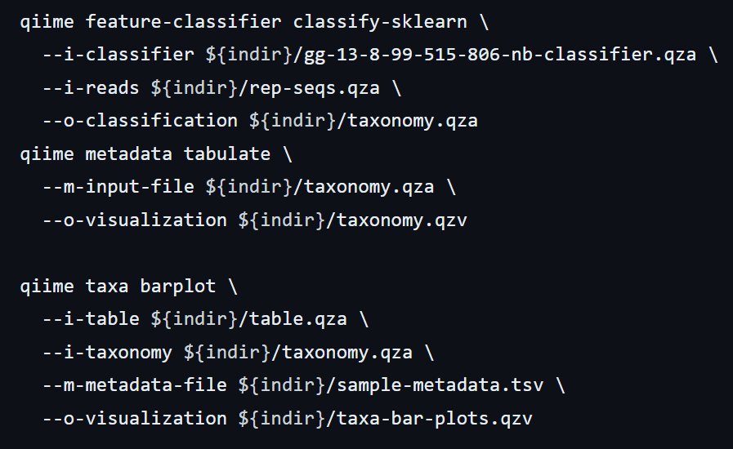
Taxonomic Analysis
Relate taxonomy to metadata
Using Naive Bayes classifier
Use bar plots to view taxonomy
Notes:
This classifier was trained on the Greengenes 13_8 99% OTUs, where the sequences have been trimmed to only include 250 bases from the region of the 16S that was sequenced in this analysis (the V4 region, bound by the 515F/806R primer pair).

Slide 20
Differential Abundance Testing & ANCOM
Analyze abundance of taxa
Assigns significance to each comparison
ANCOM
Provides more accurate assessment with high statistical power
Takes into account the structure of the data
Linear model framework and scalability
Notes:
demonstrating its general applicability to testing hypotheses about compositional differences in microbial communities.
ANCOM accounts for the underlying structure in the data and can be used for comparing the composition of microbiomes in two or more populations. ANCOM makes no distributional assumptions and can be implemented in a linear model framework to adjust for covariates as well as model longitudinal data. ANCOM also scales well to compare samples involving thousands of taxa.

Slide 21
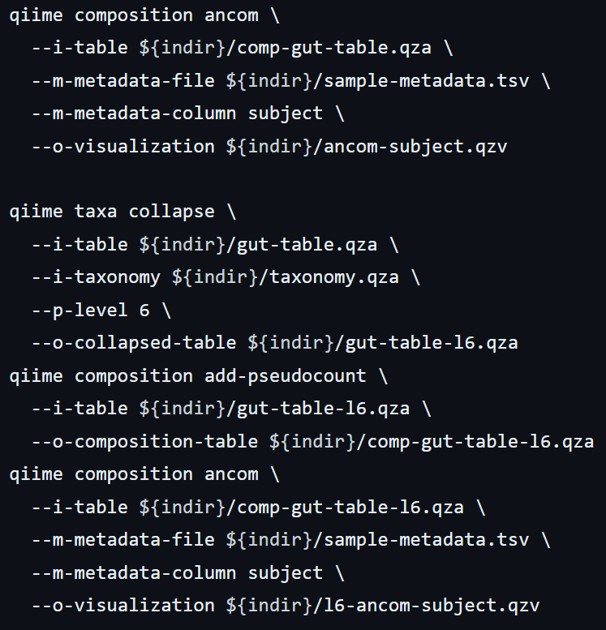
Differential Abundance Testing
ANCOM
Identifies features that are differentially abundant
Assumes less than 25% of features change between species
Requires pseudo-count to raise frequency
Can be performed on specific taxonomic level
Notes:
If you expect that more features are changing between your groups, you should not use ANCOM as it will be more error-prone (an increase in both Type I and Type II errors is possible)
ANCOM operates on a FeatureTable[Composition] QIIME 2 artifact, which is based on frequencies of features on a per-sample basis, but cannot tolerate frequencies of zero.
To build the composition artifact, a FeatureTable[Frequency] artifact must be provided to add-pseudocount (an imputation method), which will produce the FeatureTable[Composition] artifact. qiime composition add-pseudocount \

Slide 22
Interface Options
Python 3 Module
Q2Galaxy
from qiime2 import Metadata
from urllib import request
url = 'https://docs.qiime2.org/2021.11/data/tutorials/moving-pictures-usage/sample-metadata.tsv'
fn = 'sample-metadata.tsv'
request.urlretrieve(url, fn)
sample_metadata_md = Metadata.load(fn)
…
demux, demux_details = demux_actions.emp_single(
seqs=emp_single_end_sequences,
barcodes=barcode_sequence_mdc,
)
Notes:
We just wanted to show that QIIME 2 doesn’t provide only one interface for operation but 3 in total. The one we used, the Python module and the Q2Galaxy as well.

Slide 23
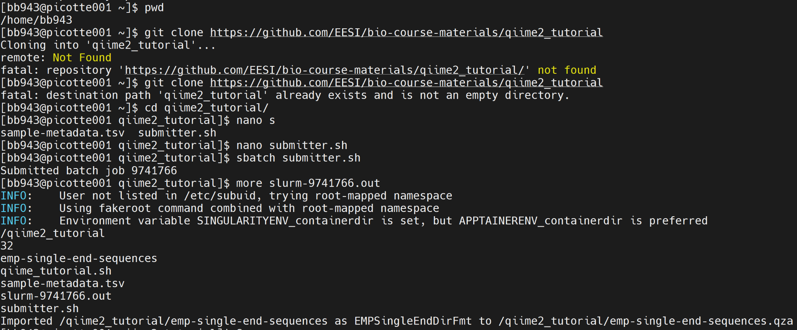
Qiime2 Data Visualization
Visualizations(view.qiime2.org)
Output files like artifacts
Tables, Graphs, etc.. in the form of .qza/.qza files

Slide 24
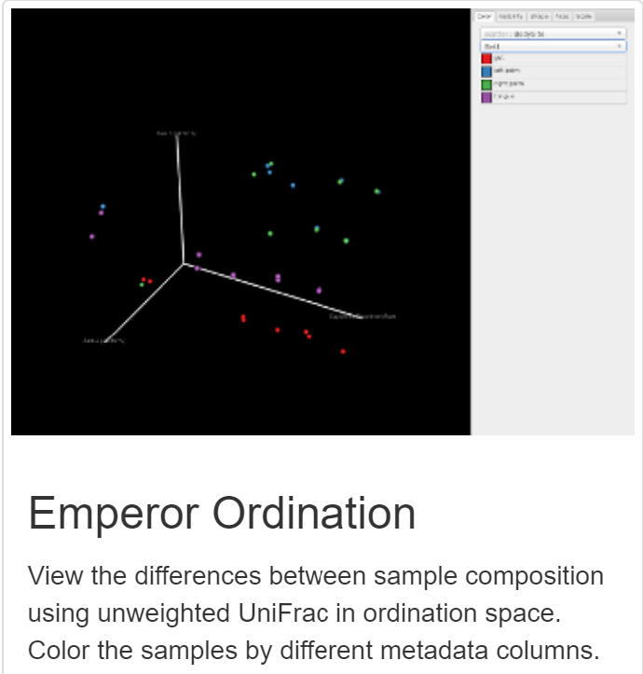
Emperor Visual
Qiime calculates the diversity between input samples and creates a Distance matrix
Distance matrix is visualized using PCoA - Principal Coordinate Analysis - and Hierarchical clustering
Similar samples appear in close clusters in the interactive 3D environment
Notes:
In practice, this means that Weighted UniFrac is useful for examining differences in community structure; Unweighted UniFrac is more sensitive to differences in low-abundance features

Slide 25
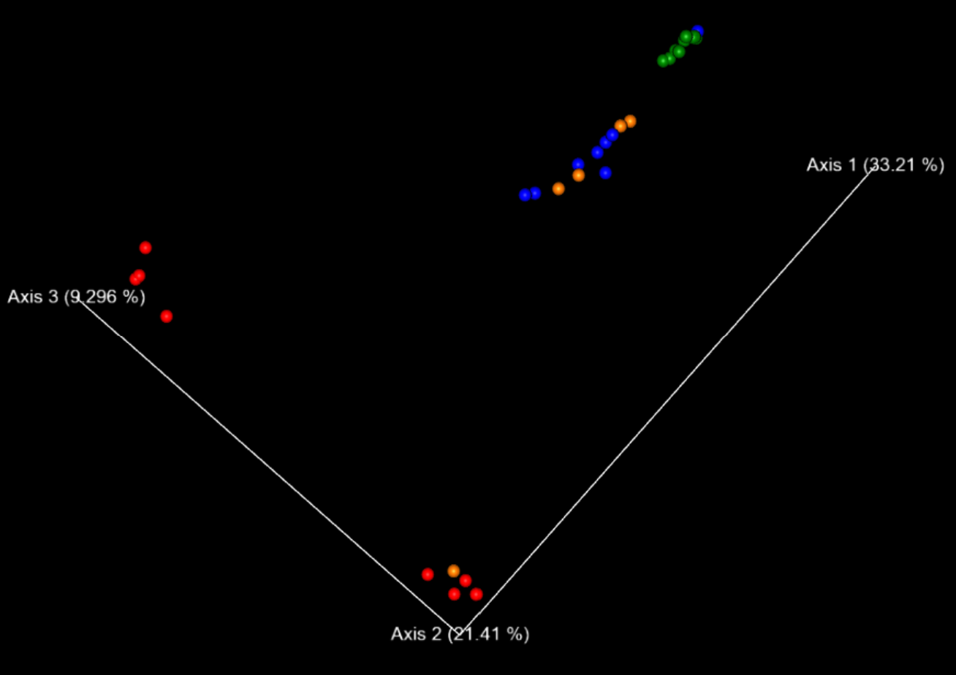
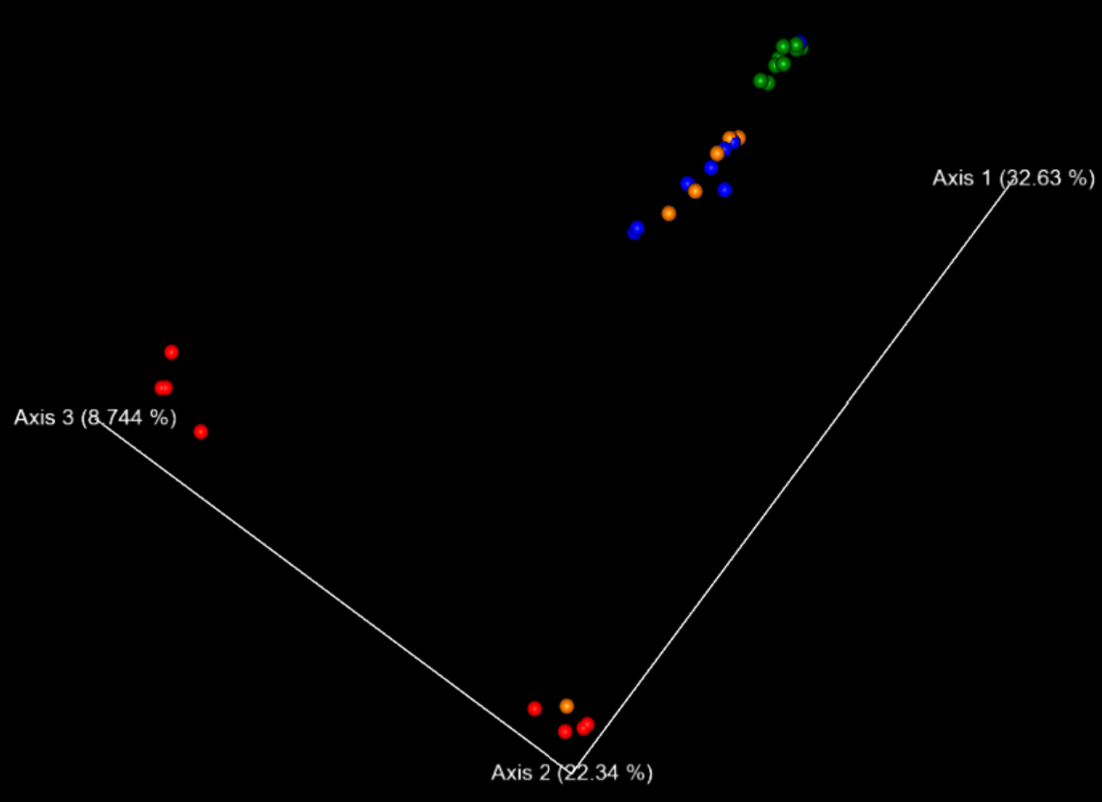
Tutorial from git repo
Tutorial (newer)

Slide 26
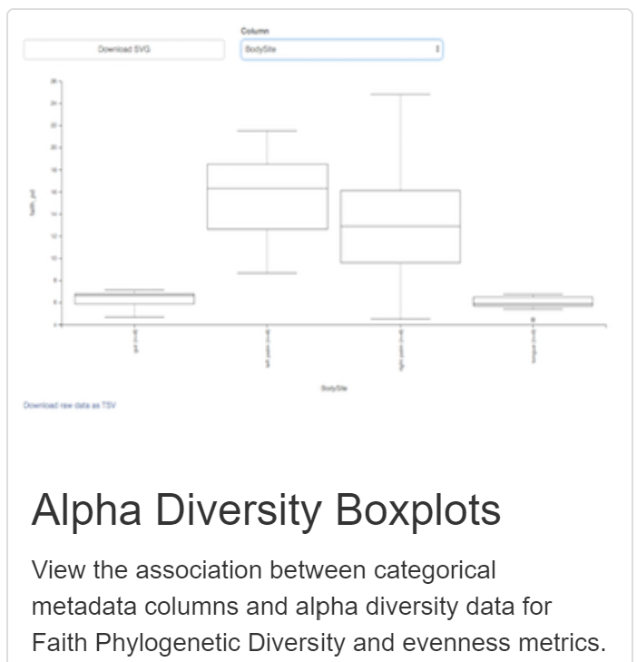
Significance Visual
Statistical significance
Helps visualize differences between alpha and beta diversities
Used to effectively display evenness and abundance of OTU’s in a group

Slide 27
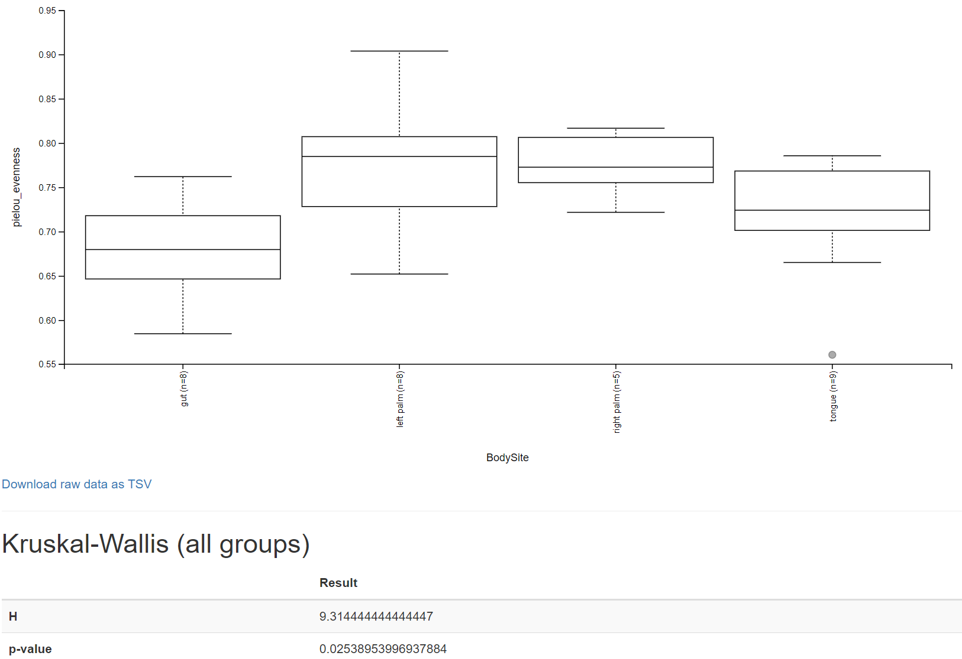
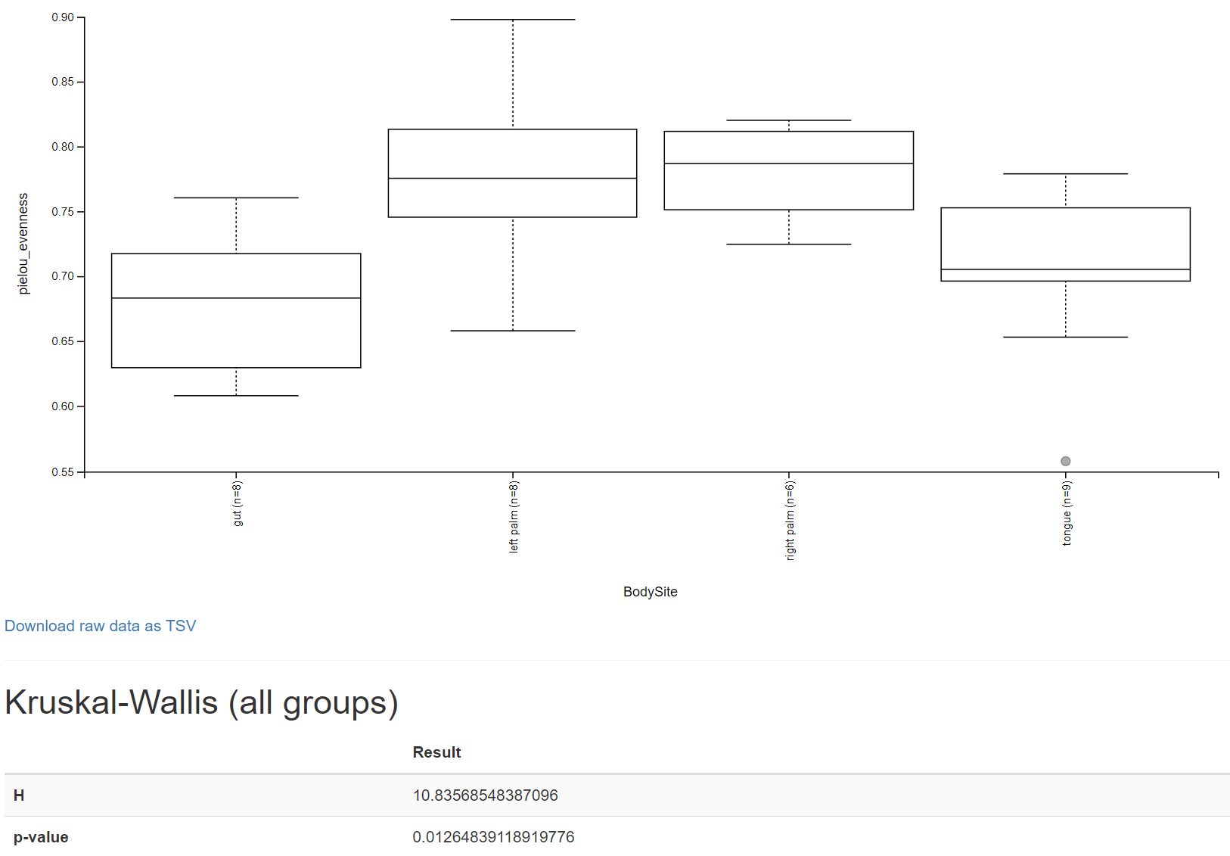
Tutorial from git repo
Tutorial (newer)
Notes:
H - values above 5 are insinuate reasonable accuracy of data distribution
P-value - probability results are due to random chance

Slide 28
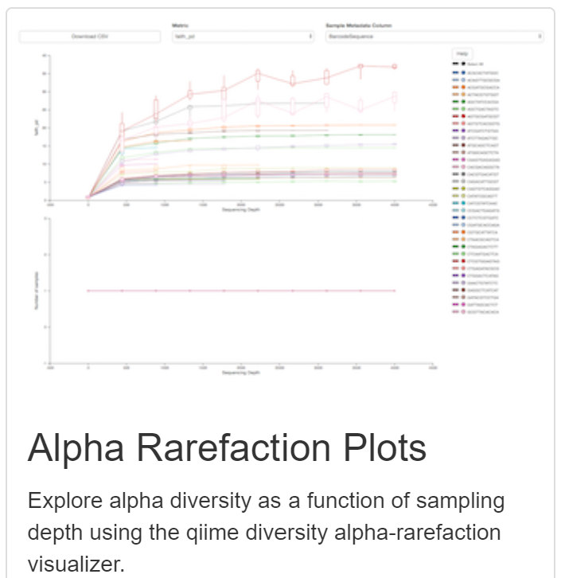
Rarefaction Visual
Analyzes sampling depth (number of sequences) of a group
This method is used to clarify the diversity of samples to eliminate false similarities due to same sequence length of staples
Defines the depth of random subsets to compare alpha diversity to not confuse sequence length
Notes:
Species diversity vs sample depth

Slide 29
Summary
QIIME can perform a plethora of microbiome analyses
Diversity Analysis
Taxonomic Analysis
Differential Abundance
Interactive models and high quality results
Multiple Interfaces

Slide 30
Sources
https://www.metagenomics.wiki/pdf/taxonomy/alpha-beta-diversity
https://docs.qiime2.org/2023.9/
https://chat.openai.com/
https://www.ncbi.nlm.nih.gov/pmc/articles/PMC4517945/#P187 - paper on visualization methods
https://forum.qiime2.org/t/emperor-for-dummies/13609

